Slide 1



SpaceBeat: Identity-aware Multi-person Vital Signs Monitoring Using Commodity WiFi
Bofan Li¹, Yili Ren², Yichao Wang¹, Jie Yang¹
¹Florida State University
²University of South Florida

Slide 2
Outlines
Motivation
Channel state information(CSI)
Previous works
Challenges
Our System
Evaluation and performance
Discussion
Conclusion

Slide 3
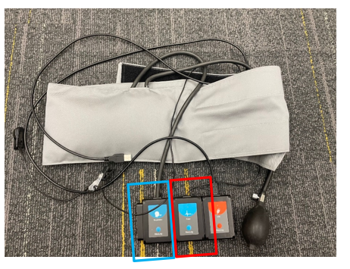
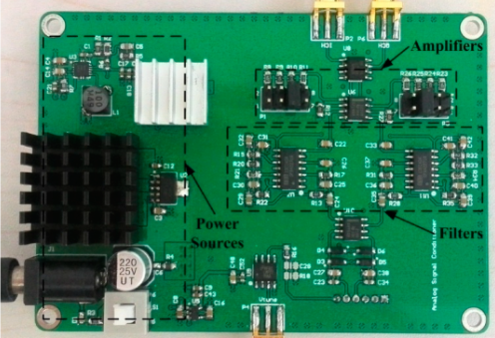



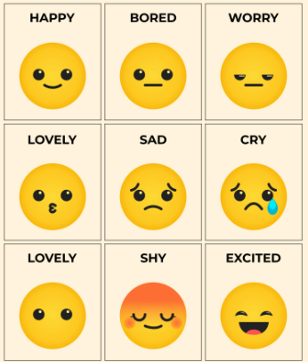


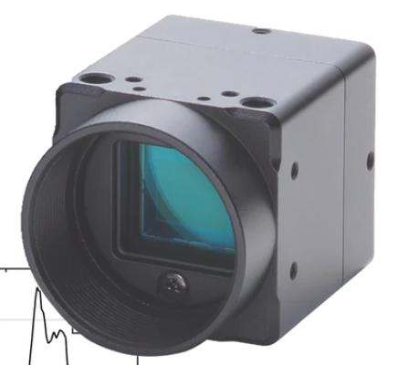
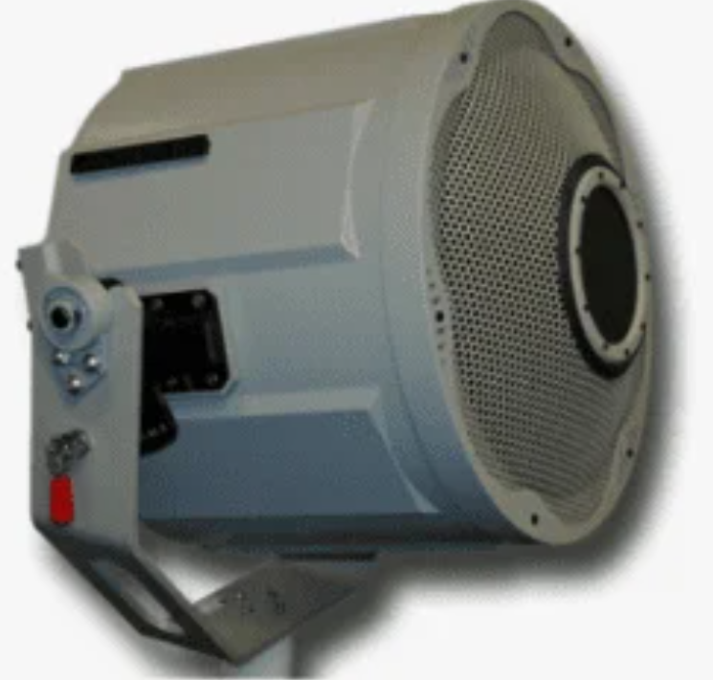
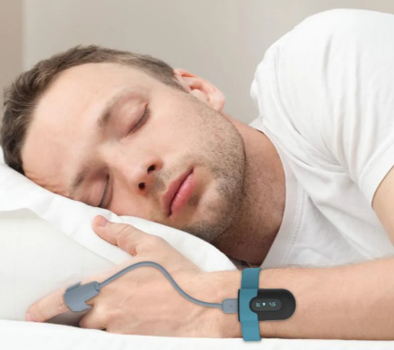




Motivation
Personal health
Wearable device:
invasive and uncomfortable
Radar:
high cost and not ubiquitous
Emotion Recognition
Monitoring
Deriving
Sleep monitoring
Vital signs
(especially breathing and heartbeat)
Camera device:
Line-of-Sight
Acoustic Device:
high cost and not ubiquitous
Person identification
?
WiFi:
contact-free, long-term, and ubiquitous
…
…

Slide 4


Channel State Information
CSI describes how signals propagate from the transmitter to the receiver at certain carrier frequencies. CSI amplitude and phase are impacted by multi-path effects, including amplitude and phase.
Transmitter
Receiver
Frequency domain representations
transmitted
X(f,t)
Frequency domain representations
received
Y(f,t) = H(f,t) * X(f,t) + N
H(f,t)

Slide 5
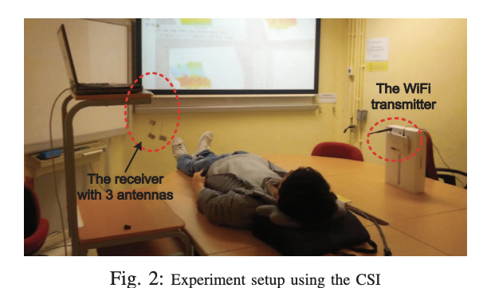
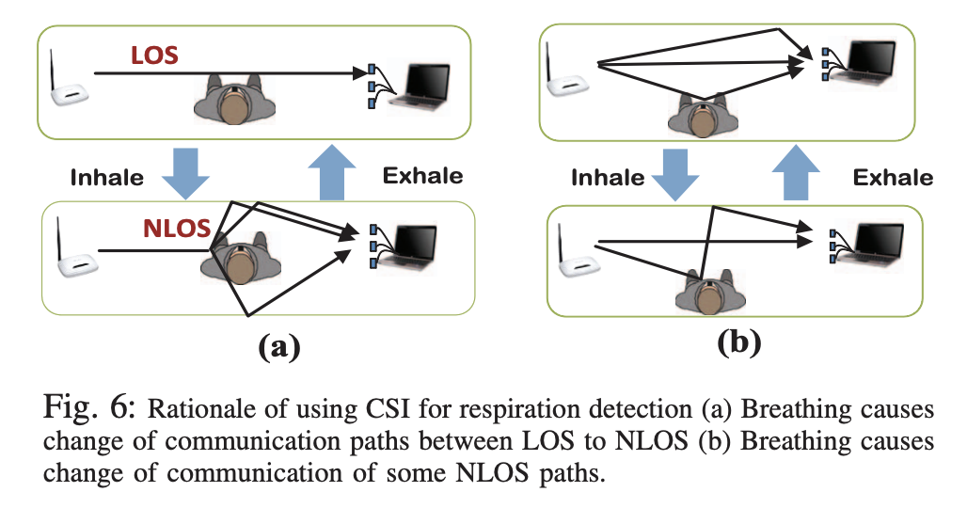
Previous Works
Xuefeng Liu, Jiannong Cao, Shaojie Tang, and Jiaqi Wen. 2014. Wi-sleep: Contactless sleep monitoring via wifi signals. In 2014 IEEE Real-Time Systems Symposium. IEEE, 346–355.
CSI data processing steps
Outlier removal
Interpolation
Noise filtering
Subcarrier selection

Slide 6
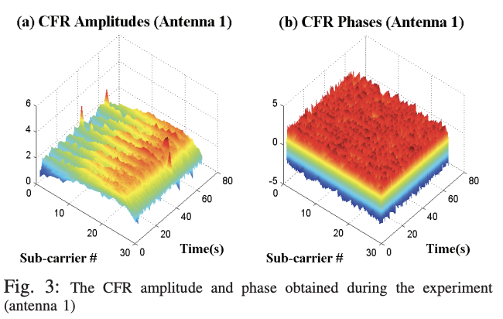
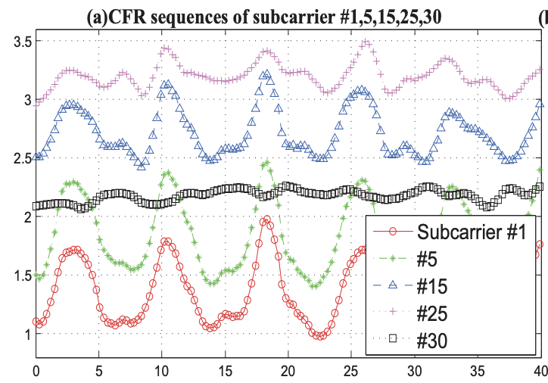
Previous Works
The first sleep monitoring based on WiFi CSI signals.
Respiration only.
2. Single person
3. Static and clean environment

Slide 7
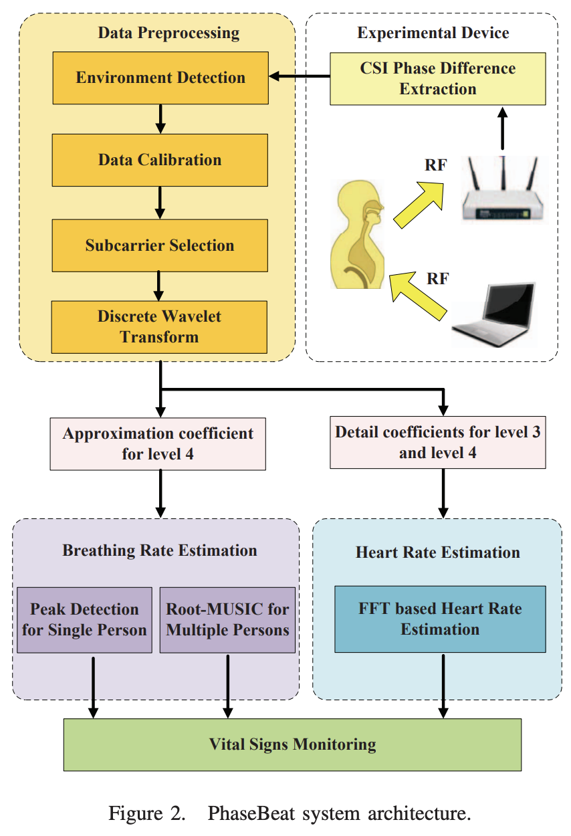
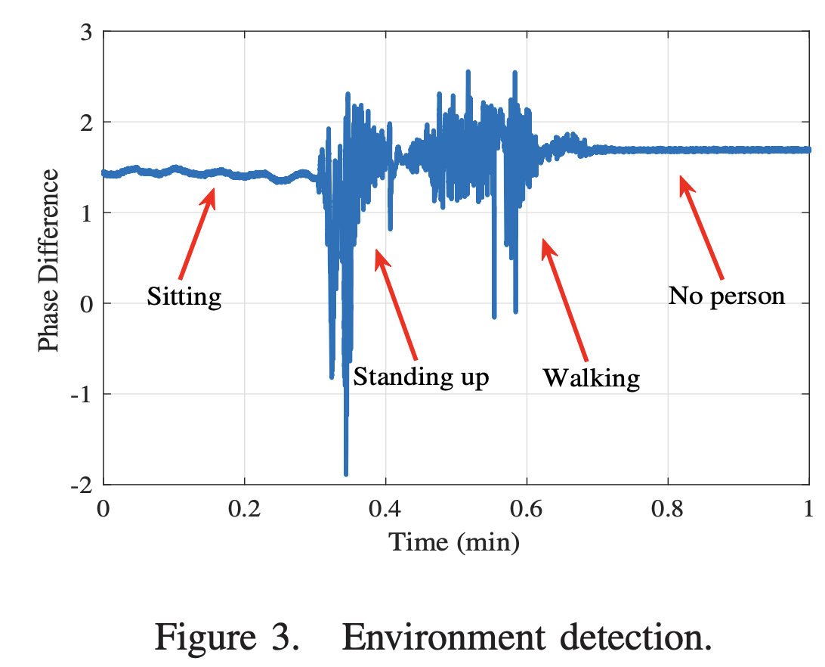
Previous Works
Xuyu Wang, Chao Yang, and Shiwen Mao. 2017. PhaseBeat: Exploiting CSI phase data for vital sign monitoring with commodity WiFi devices. In 2017 IEEE 37th International Conference on Distributed Computing Systems (ICDCS).

Slide 8
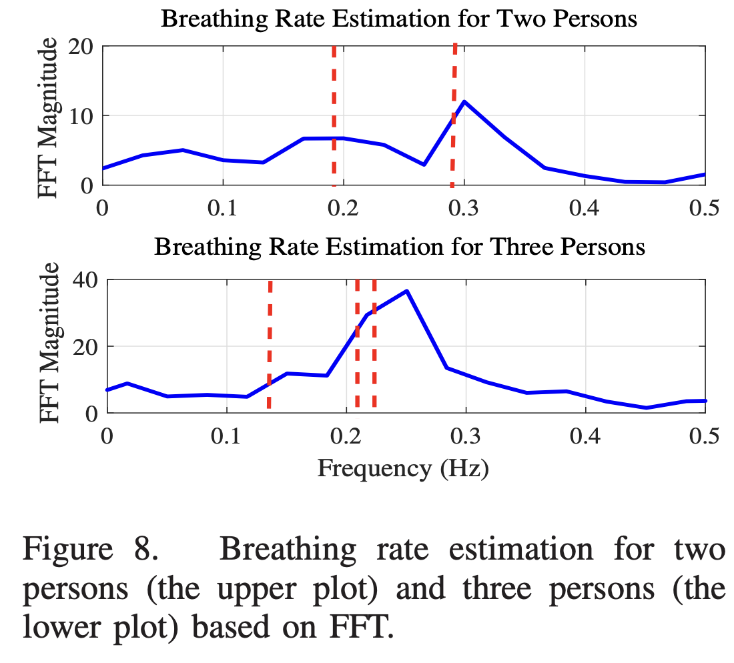
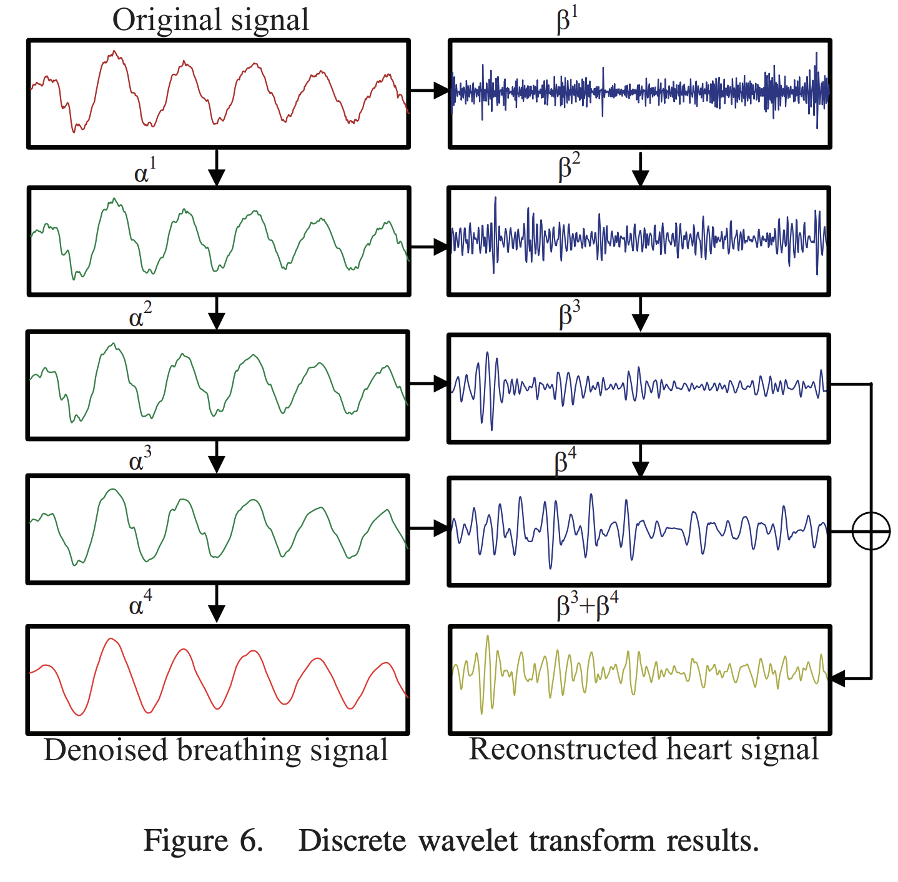
Previous Works
Breathing rate estimation accuracy 98%
Heartbeat rate estimation accuracy 88%
Multi-person, Not identity-aware
Not robust to interference

Slide 9
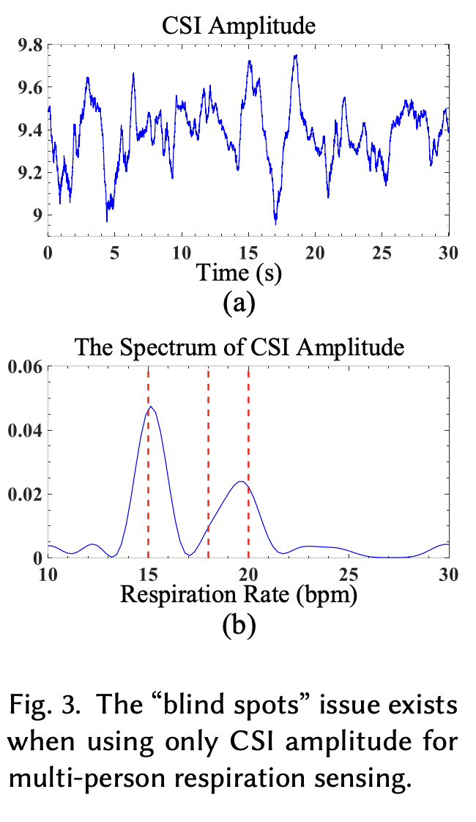
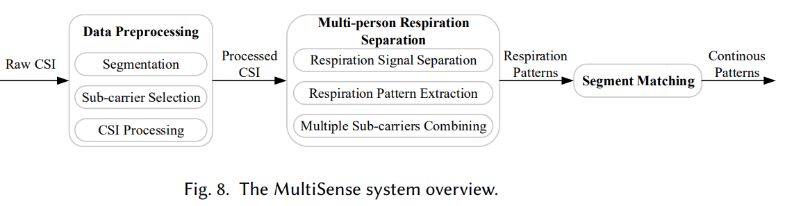
Previous Works
Youwei Zeng, Dan Wu, Jie Xiong, Jinyi Liu, Zhaopeng Liu, and Daqing Zhang. 2020. Multisense : Enabling multi-person respiration sensing with commodity wifi. IMWUT 4, 3 (2020), 1–29.
"The reflected signals are linearly mixed"
"Model the multi-person respiration sensing as a blind source separation (BSS) problem."
"We solve it using independent component analysis (ICA) to separate the mixed signal."

Slide 10
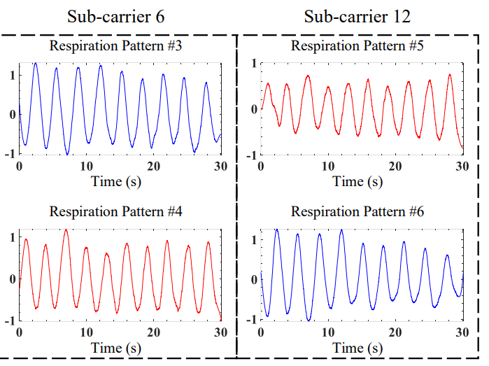


Previous Works
Breathing rate estimation accuracy 98.5%
Multi-person,
Not identity-aware
Not robust to interference

Slide 11
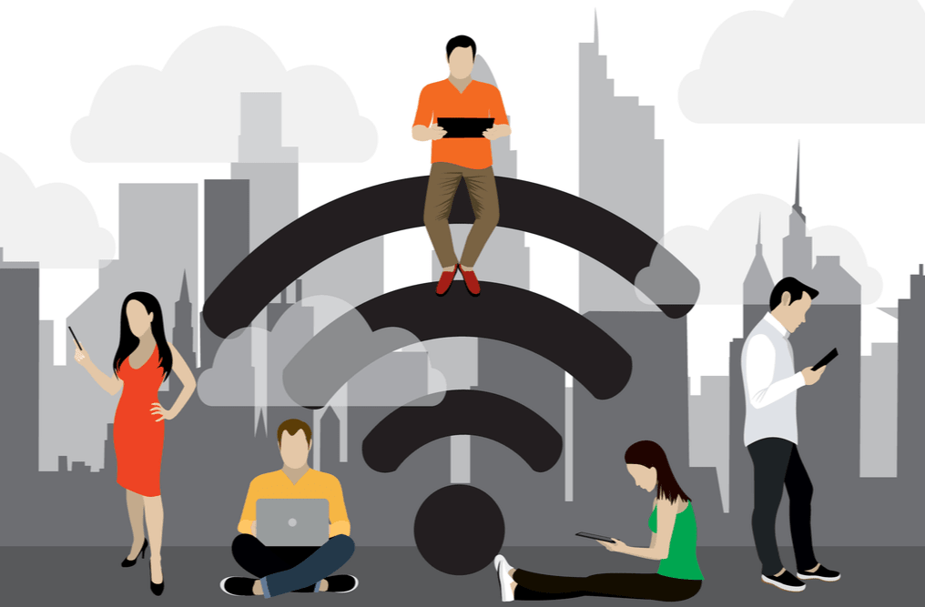
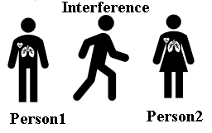
Challenges
Identity-aware Multiple person.
Interference.
How to robustly track multiple people’s vital signs using WiFi?

Slide 12
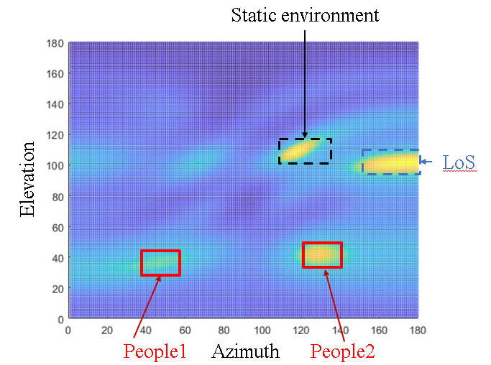
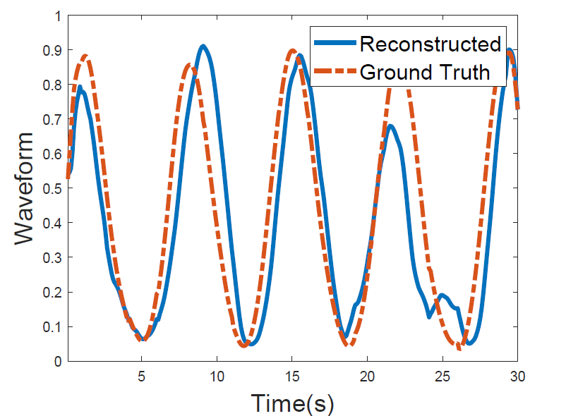
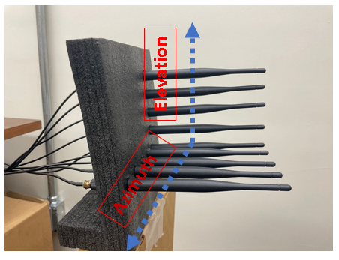
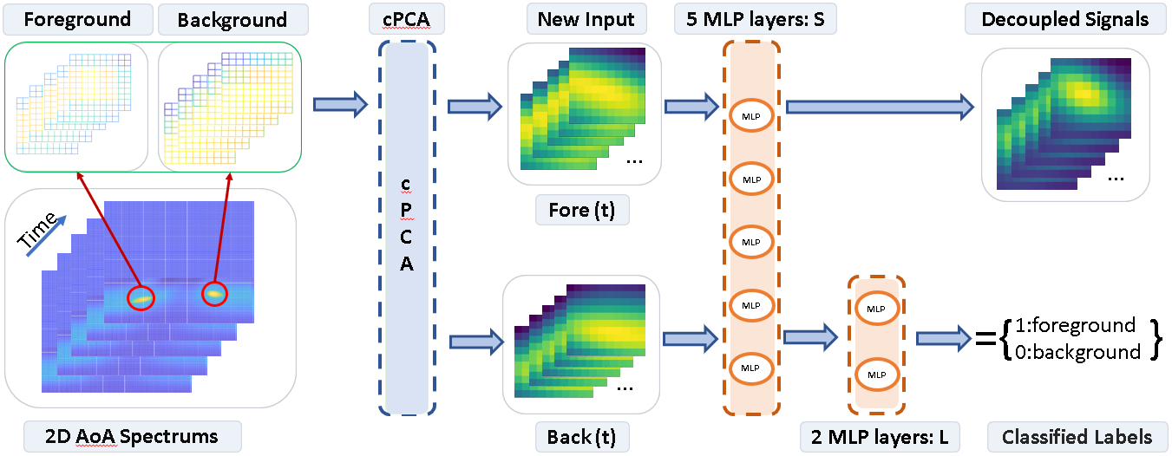

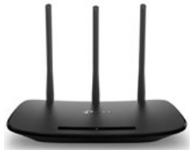
Our Solution: SpaceBeat
An identity-aware and interference-robust multi-person vital sign monitoring system using commodity WiFi
WiFi devices
Multiple antennas on both WiFi transmitter and receiver
Separate different people in spatial domain
Explainable spatial and temporal information of human vital signs
cPCA-CL network
Decoupling technique to further mitigate interference.
Reconstructed human vital signs
Respiration
and heartbeat rate.

Slide 13
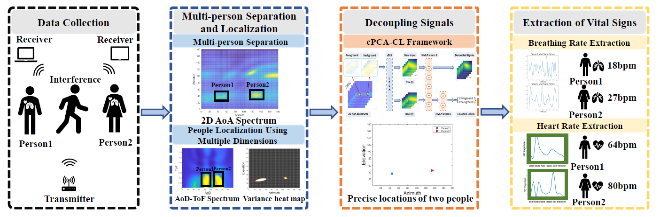
SpaceBeat System

Slide 14
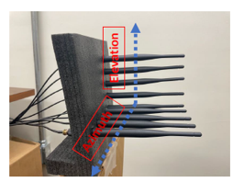
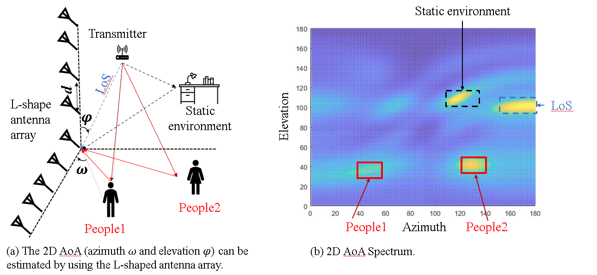
Multi-person Separation and Localization

Slide 15
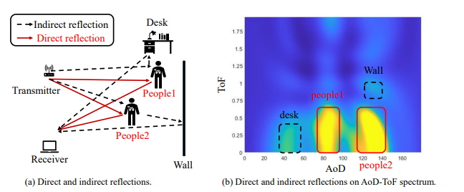
Multidimensional Information

Slide 16
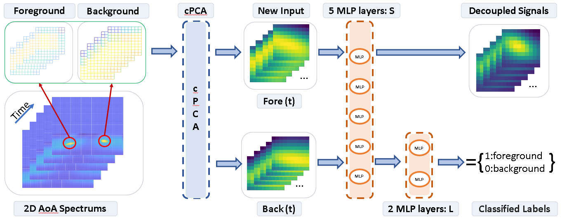
cPCA-CL network

Slide 17
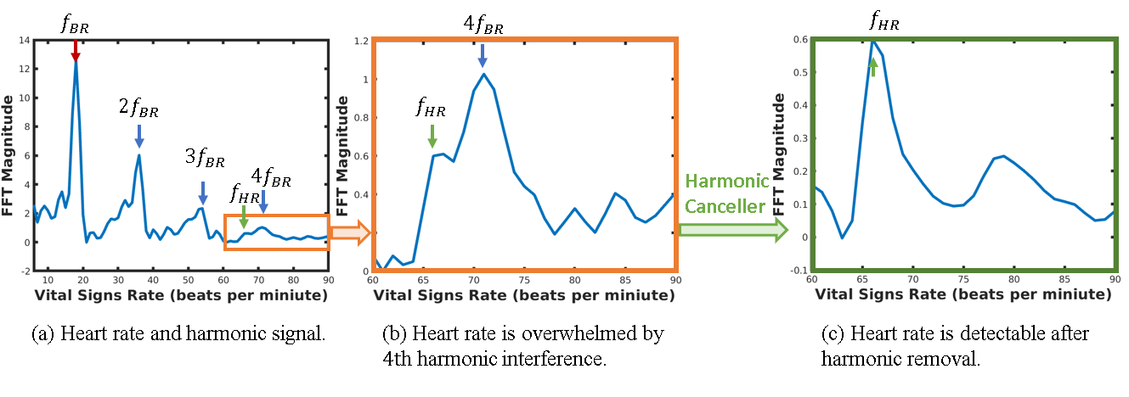
Harmonic Removal

Slide 18
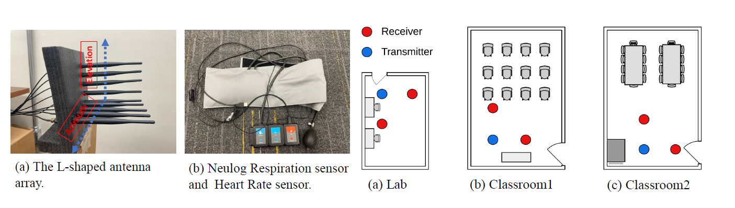
Experimental Setup
Device: receiver
Device: collecting ground truth
Experiment: environment

Slide 19
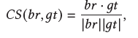
Data Collection and Evaluation Metrics
Data Collection
14 volunteers.
All of them are monitored in their natural state.
Evaluation Metrics
We utilize bpm as one of the evaluation metrics for breathing rate and heart rate.
Breaths Per Minute (bpm) is a metric that quantifies the number of complete respiratory cycles a person takes within one minute.
Beats Per Minute (bpm) is a measure of the heart rate, representing the number of times the heart beats within one minute.
we use cosine similarity to evaluate the coefficient between reconstructed waveform (br) and ground truth (gt).

Slide 20
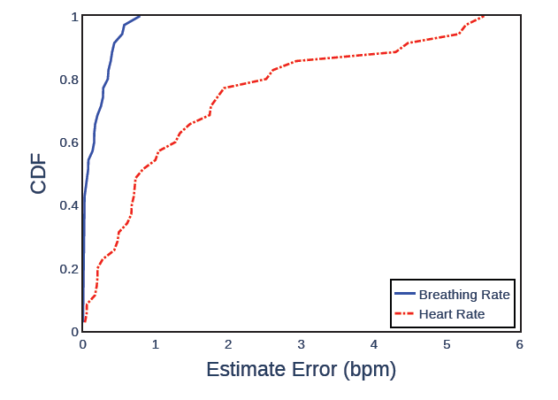
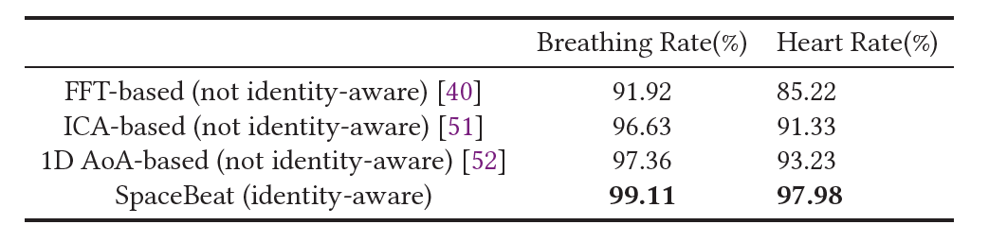
Performance Evaluation
Overall system performance comparison

Slide 21
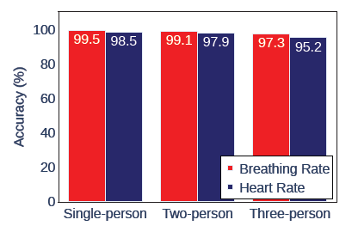
Performance Evaluation
Impact of Different Numbers of People

Slide 22
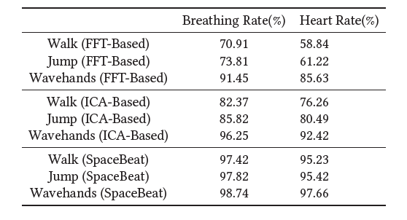
Performance Evaluation
Impact of Interference

Slide 23
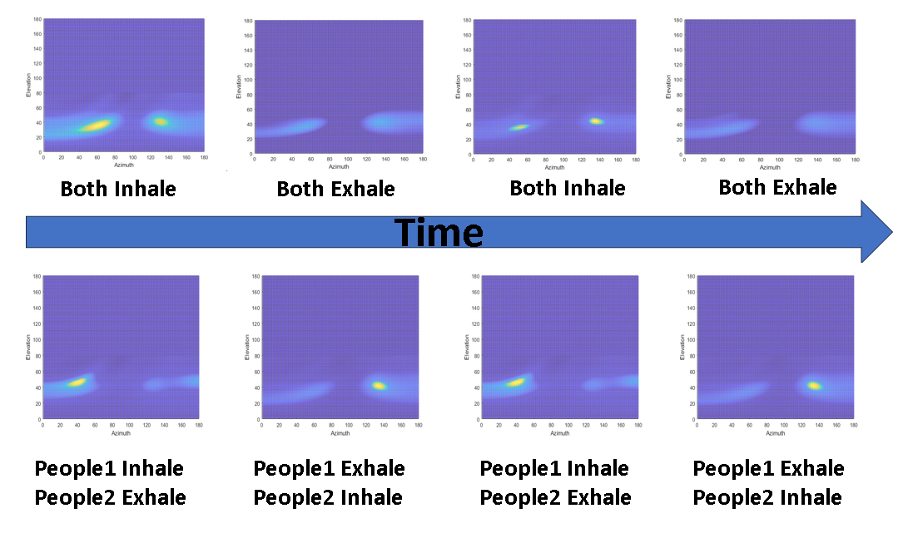
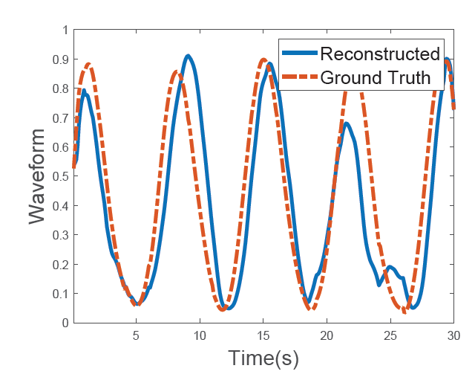
Performance Evaluation
Reconstructed waveform and ground truth waveform

Slide 24
Discussion
Real-time Implementation
Currently, with limited consumer-grade computational resources, our system is not able to process the 4D MUSIC algorithm in real time.
Possible Solutions
1.Reducing the number of steps for searching in each dimension.
2.Explore alternative algorithms that reduce dimensions.

Slide 25
Conclusion
We propose a commodity WiFi-based identity-aware and interference-robust vital signs monitoring system. It works for multi-person scenarios.
Our system can reuse WiFi devices for a long-term monitoring.
Our system achieves high accuracy in vital signs monitoring under various challenging environments by eliminating interferences with the CPCA-CL model and improving the SNR of heartbeat using a harmonic canceller.

Slide 26
Thank You!
&
Questions!
Jie Yang
jyang5@fsu.edu

